Slide 1
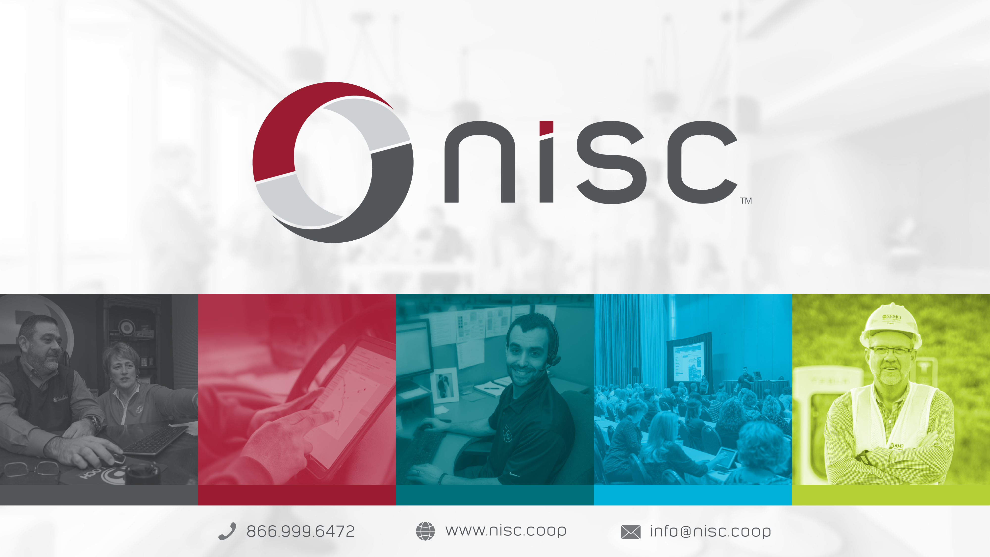

Slide 2
Build & Deployment Framework Updates/Roadmap
Seanie Gleason

Slide 3
Framework Teams Goal
Provide a cloud computing framework that delivers a complete cloud platform – hardware, software, and infrastructure – for developing, running, and managing applications.

Slide 4

“Bring a Jar, and we will run it in the cloud”

Slide 5
NISC’s Paas for Internal Developers
Software – (Java, JavaScript)
Web, Security, Messaging, Business Logic
Hardware (Containers)
OS Security, 3rd party containers
Infrastructure - (Kubernetes)
Our Saas. Runs containers, manages URL’s, etc.
Orchestration – (Gradle)
Where will the application be built, verified, and deployed to our Saas?
Bamboo
Bitbucket Cloud
Where do we store our binaries for Containers?
Artifactory
Where do we store our Containers for our Saas?
Harbor/artifactory
Notes:
This is the ‘as of today’ expectations for developers and new hires to build an application at NISC. And that’s a lot! We want to focus on the business logic, since that’s where our value add is for NISC.

Slide 6
Components for Our Internal Developers with a Paas
Software – (Java, JavaScript)
Web, Security, Messaging, Business Logic
Hardware (Containers)
OS Security, 3rd party containers
Infrastructure - (Kubernetes)
Our Saas. Runs containers, manages URL’s, etc.
Orchestration – (Gradle)
Where/How will the application be built, verified, and deployed to our Saas?
Bamboo
Bitbucket Cloud
Where do we store our binaries for Containers?
Artifactory
Where do we store our Containers for our Saas?
Harbor/ Artifactory
Notes:
This is what our Web Developers should be focused in on, the Source Code. Along with the money making business logic section of writing code, we can innovate and build stronger/faster/better applications by leveraging these frameworks with our business code.

Slide 7
Current State of the Components
Software – (Java, JavaScript)
Web, Security, Messaging, Business Logic
Hardware (Containers)
OS Security, 3rd party containers
Infrastructure - (Kubernetes)
Our Saas. Runs containers, manages URL’s, etc.
Orchestration – (Gradle)
Where/How will the application be built, verified, and deployed to our Saas?
Bamboo
Bitbucket Cloud
Where do we store our binaries for Containers?
Artifactory
Where do we store our Containers for our Saas?
Harbor/ Artifactory
Notes:
Most developers don’t worry about how their ochestration

Slide 8
Orchestration Roadmap
Build
Create standards for what it means for an application to have ‘production readiness’
Create a framework to enable checks to enforce ‘production readiness’
Deployment
Create a framework to enforce our ‘production readiness’
Provide a path for an application to deploy to production

Slide 9
Build - “Production Readiness”
What is NISC’s standard for an application to run in a live production environment?
Security
Code Styling / Format
Testing
Metrics / Alerts

Slide 10
Build - “Production Readiness” - Security
Oauth Security
required in production, latest (safest) security standard available for web applications
CVE Scanning
Binaries/Containers run through a vulnerability scan to ensure CVE’s are not included in your application and deployed to production.

Slide 11
Build - “Production Readiness” - Testing
Unit Testing - Test Driven Development
Business code works as intended
Forces a familiar coding style and design for all apps
Singleton class patterns
Integration/Contract Testing
Application code works as intended
Ensures ‘API First’ approach
Mutation Testing
Ensures unit tests don’t include ‘true=true’

Slide 12
Build - “Production Readiness” - Other
Code Styling / Format
Ensures code readability between teams and newcomers
Metrics / Alerts
React to application failures quickly

Slide 13
Build – What is a Build?
A set of steps taken to transform source code into a binary application.
Gradle
OOTB Gradle provides a task called ‘build’ but leaves the implementation up to you.

Slide 14
Build – What is a Build Framework?
In addition to producing a binary, a framework adds additional tasks that are required to build the structure of the binary.

Slide 15
Build Framework Example - Testing
By default, the ‘java’ gradle plugin includes ‘test’ in the ‘build’ task.
However, it leaves the implementation of how that task runs up to you.
java {
useJunitPlatform()
}
Adds the junit runner to be included while running ‘test’ (i.e. Scan your project for any @Test and run)

Slide 16
Build Framework Example – Spring Boot
Altough the ‘java’ gradle plugin includes a ‘jar’ in the ‘build’ task, it does not bundle any required libraries that may be required to run the application.
plugins {
id(”org.springframework.boot”)
}
Adds a ‘bootJar’ task to the ‘build` task. This not only compiles your jar but includes all the libraries listed in your ‘dependencies’ section of your build.

Slide 17
Build Framework Roadmap
Autoconfigure Plugins
id("application")
id("java")
id("jacoco")
id("info.solidsoft.pitest")
id("maven-publish")
id("au.com.dius.pact")
id("com.jfrog.artifactory")
id("coop.nisc.dockerbuildx")
id("coop.nisc.helmsman")
id("coop.nisc.gitversion")
id("coop.nisc.opinionated.gradle")
id("org.springframework.boot")
Dependency Management
Web Applications
Libraries

Slide 18
Build Framework Roadmap
Autoconfigure Plugins
id("application")
id("java")
id("jacoco")
id("info.solidsoft.pitest")
id("maven-publish")
id("au.com.dius.pact")
id("com.jfrog.artifactory")
id("coop.nisc.dockerbuildx")
id("coop.nisc.helmsman")
id("coop.nisc.gitversion")
id("coop.nisc.opinionated.gradle")
id("org.springframework.boot")
Dependency Management
Web Applications
Libraries

Slide 19
id(”coop.nisc.framework.spring-boot-nisc”)

Slide 20
Build Framework Requirements for Publishing
Unit Test code coverage checks (75%) – Jacoco
Mutation Testing failure thresholds (75%) – PIT
Integration Testing requirement (Karate, Citrus, Cucumber, etc.)

Slide 21
Build – Releasing the binary
‘releaseAll’ gradle task
Combines the building of the application and its publication to remote repositories.
`gradle build artifactoryPublish’

Slide 22
Deployment – “Production Readiness”
Source Code Verifications
Unit Tests
Mutation Tests
Git Secrets scanning
Binary Application Verifications
Integration Tests
Artifactory CVE Scanning
Publish Binary/Container to Remote Repository
Habor
Artifactory
Deploy to Kubernetes
kubectl

Slide 23
Deployment – “Production Readiness” Ownership
Source Code Verifications (Product)
Unit Tests
Mutation Tests
Git Secrets scanning
Binary Application Verifications (Security/API)
Integration Tests
Artifactory CVE Scanning
Publish Binary/Container to Remote Repository (Hardware)
Habor
Artifactory
Deploy to Kubernetes (Infrastructure)
kubectl

Slide 24
Deployment – Getting to Production
Stash and Bamboo
Self hosted git repository and deployment orchestration server.
Ended support on February 15, 2024
Bitbucket Cloud
Latest offering and suggested alternative to Bitbucket Server
Saas CI/CD Pipeline in place of the deployment orchestration sever

Slide 25
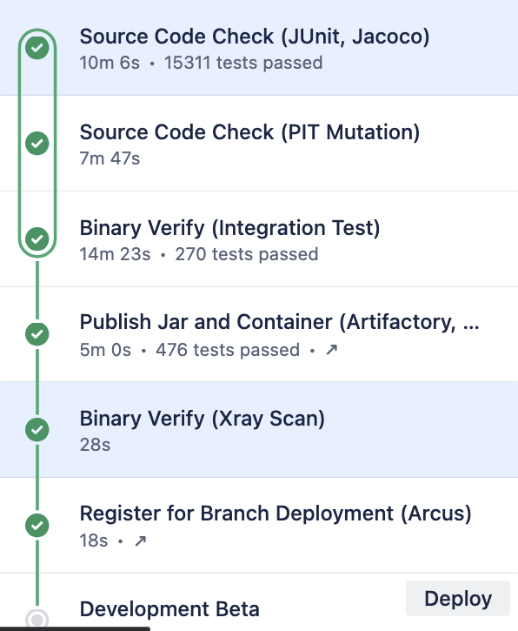
Deployment – Getting to Production – Bitbucket Cloud – Pipeline

Slide 26
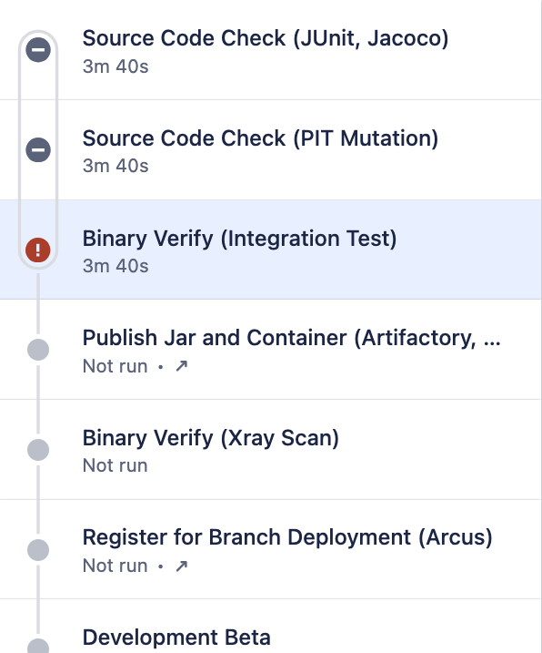
Deployment – Getting to Production – Bitbucket Cloud – Pipeline

Slide 27
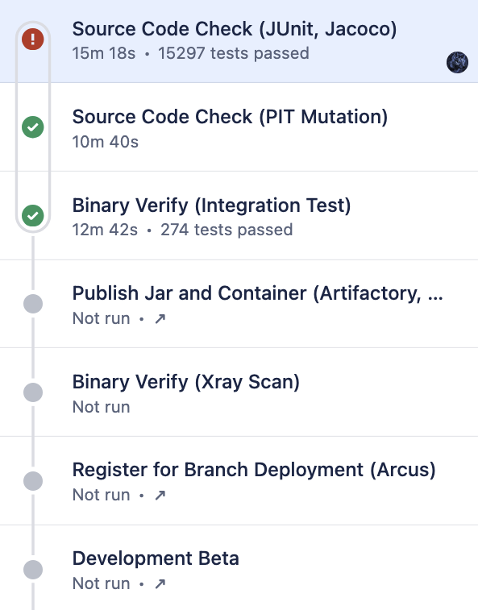
Deployment – Getting to Production – Bitbucket Cloud – Pipeline

Slide 28
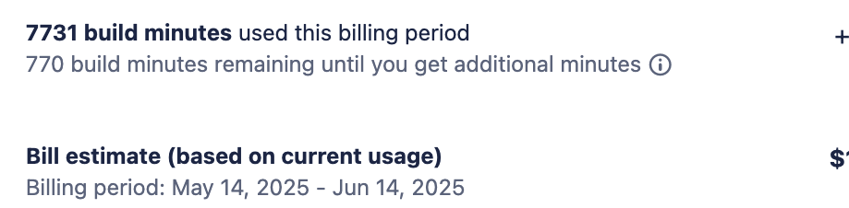
Deployment – Getting to Production – Bitbucket Cloud – Pipeline

Slide 29
Deployment – Getting to Production – Stash/Bamboo
Create your application using start.arcus.coop.
Register your application
GIT repository in Stash
Add your application to Helm Config
OAuth2 Registration with Auth Server
Kubernetes Application Registry
Connect Project Configuration Repository

Slide 30
Deployment – Getting to Production – Bitbucket Cloud
Create your application using start.arcus.coop.
Register your application
GIT repository in Bitbucket Cloud
Add your application to Helm Config
OAuth2 Registration with Auth Server
Kubernetes Application Registry

Slide 31
Bitbucket Cloud Migration
Migrate to the ‘coop.nisc.framework.spring-boot-nisc’ plugin and use the ‘releaseAll’ task in bamboo.
Add the latest ‘bitbucket-pipelines.yaml’ to the root of your project
Push your application to Bitbucket Cloud

Slide 32
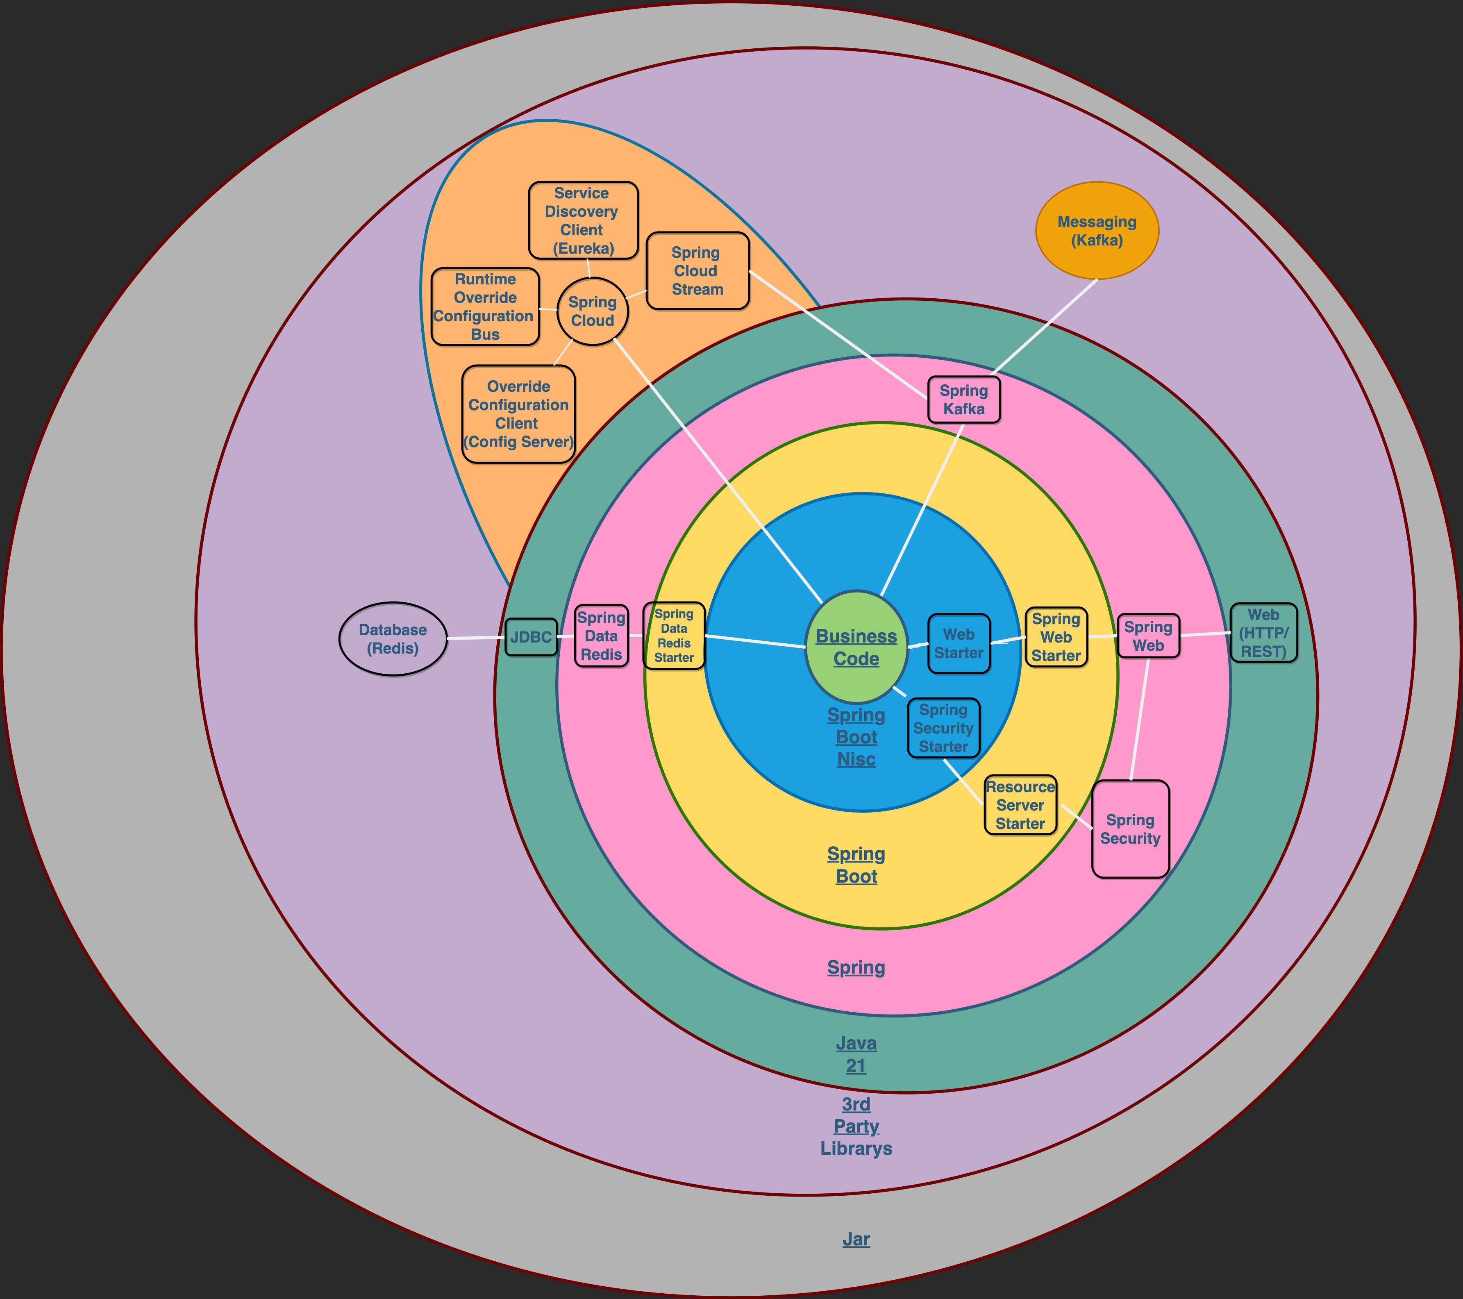

Slide 34
Thanks!
seanie.gleason@nisc.coop
seanie@gleason.tech

